Slide 1

Blinkit Retail Dashboard: Sales, Outlet, and Item Analysis
Prepared by:
-Anurag Srivastava
Date: 26 August, 2024

Slide 2
TABLE OF CONTENTS
INTRODUCTION
2. BUSINESS REQUIREMENT
3. METHODOLOGY
4. RESULTS
5. INSIGHTS DRAWN
6. CONCLUSION

Slide 3

INTRODUCTION
This project provides a comprehensive Power BI dashboard for Blinkit, India's last-minute delivery app, formerly known as Grofers. Blinkit is a quick-commerce platform that specializes in delivering groceries, fresh produce, household essentials, and more within minutes to its customers. As one of the pioneers of the "instant delivery" model in India, Blinkit caters to a rapidly growing demand for ultra-fast, last-minute deliveries, especially in urban and suburban areas.
The Power BI dashboard analyzes Blinkit's sales data across various outlets and item categories, providing a detailed overview of key metrics such as total sales, average sales per outlet, the number of items sold, and outlet performance based on size, location, and item type. The analysis also offers insights into customer preferences, outlet-specific performance, and product trends, helping Blinkit optimize its operations and tailor its services to meet customer needs more effectively.

Slide 4
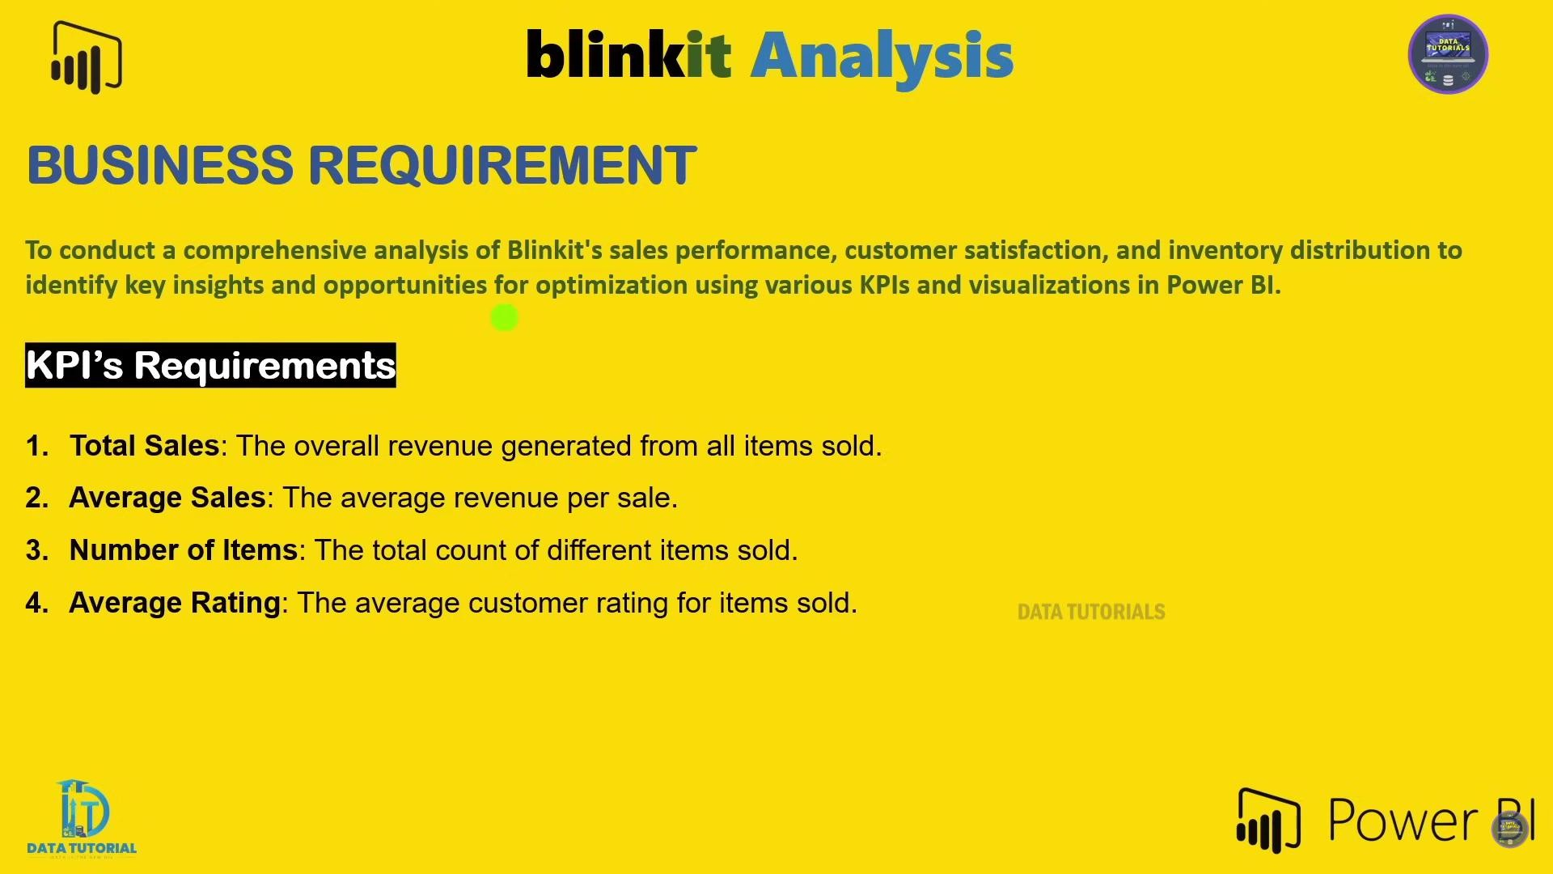
BUSINESS REQUIREMENT

Slide 5
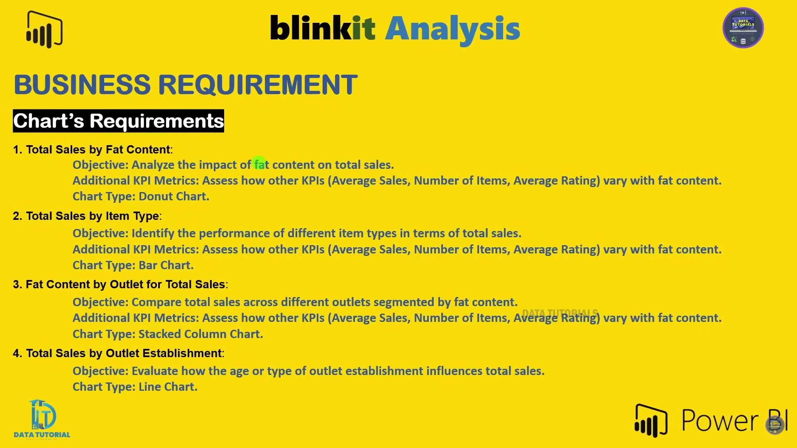

Slide 6
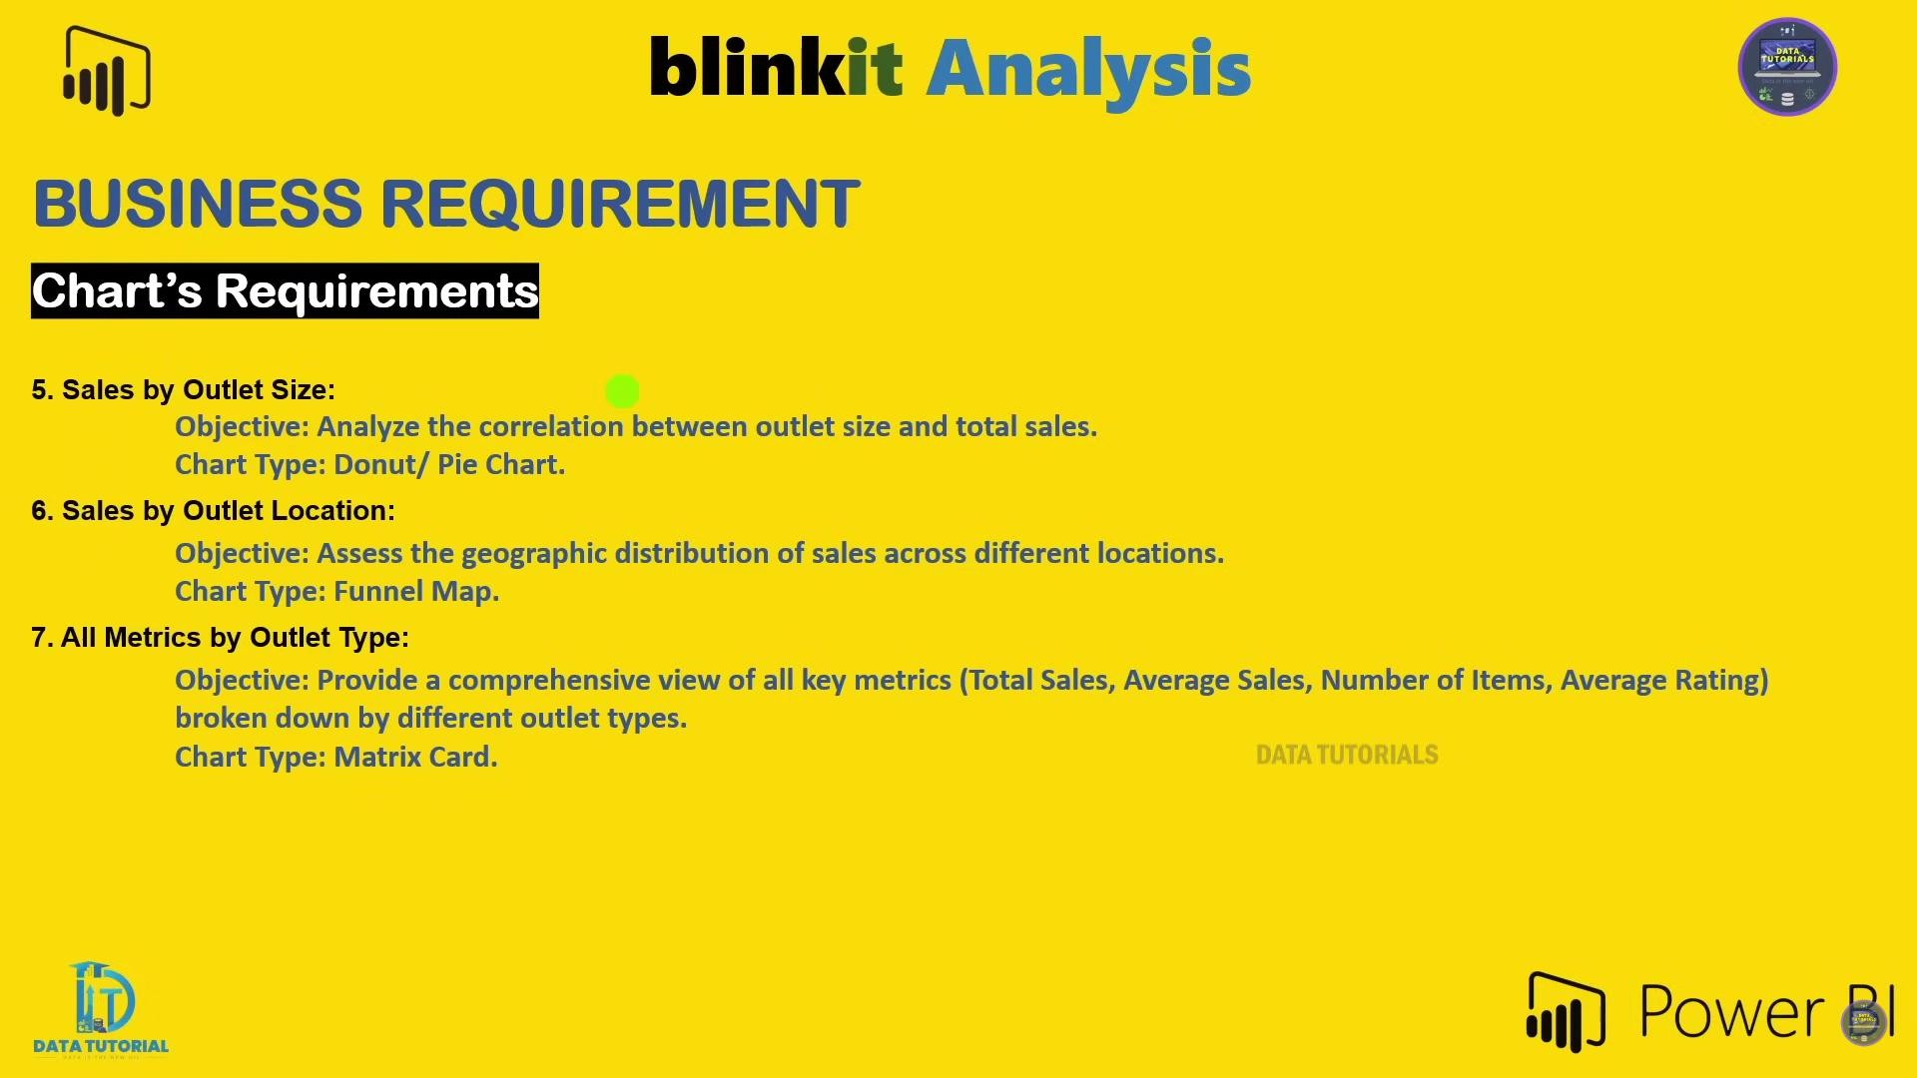

Slide 7
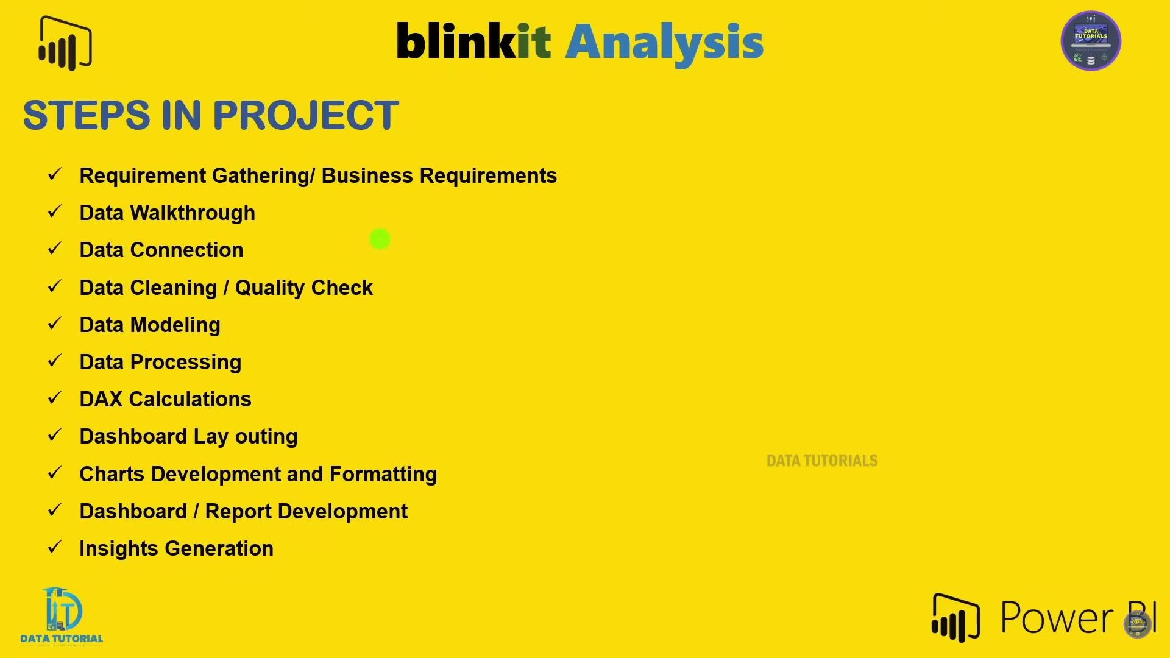
METHODOLOGY

Slide 8
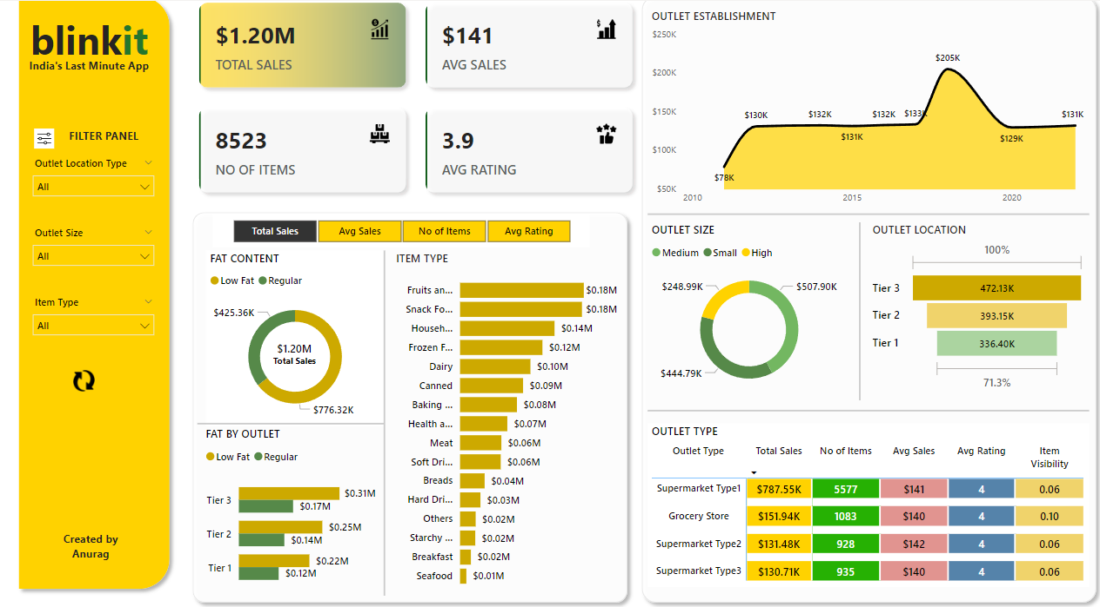
RESULT

Slide 9
INSIGHTS DRAWN
Total Sales & Average Sales: The dashboard highlights a total sales figure of $1.20M with an average sales value of $141 across all outlets. This suggests that the business is generating significant revenue but might need to analyze whether the average sale per transaction can be improved.
Outlet Performance by Size & Location:
Medium-size outlets contribute the most to sales ($507.9K), followed by small-sized outlets ($444.7K). High-size outlets have lower sales ($248.9K), which suggests the need to assess whether high-size outlets are underperforming due to their size, location, or because they are newly established .
Tier 3 locations generate the most sales ($472.1K), followed by Tier 2 ($393.1K) and Tier 1 ($336.4K). This indicates that Tier 3 outlets are the most profitable, which could lead to opportunities for expansion in such locations.
Sales by Item Type: The item types that contribute the most to total sales include:
Fruits and Vegetables and Snack Foods both generate $0.18M each, followed by Household Items at $0.14M. These categories are top performers, suggesting a focus on stocking and promoting these items further.

Slide 10
INSIGHTS DRAWN
Fat Content & Sales Distribution:
Regular Fat products account for $425.36K in sales, whereas Low Fat products dominate with $776.32K. This indicates customer preference leans towards low-fat items, but regular-fat products still make up a substantial portion.
Outlet Type Performance:
Supermarket Type 1 is the top performer with total sales of $787.55K and 5577 items sold, while other outlet types such as Grocery Stores and Supermarket Type 2 contribute much less to total sales and item count. This shows that supermarket-style outlets are far more profitable than smaller grocery stores.
Outlet Performance by Establishment Year:
Outlets established in earlier years show lower sales, with those established in 2018 performing the best, contributing significantly more than outlets established in prior years.
Customer Rating:
The average rating of 3.9 is below the desired 4.0, suggesting the need to improve customer satisfaction through enhanced service or product quality to boost overall ratings and drive better customer engagement.

Slide 11
CONCLUSION
These insights can be leveraged to make strategic business decisions such as expanding high-performing outlets, promoting top-selling items like Fruits and Vegetables, and evaluating the performance of underperforming categories or locations.
Additionally, addressing the lower-than-expected average customer rating of 3.9 by improving service quality could help increase customer satisfaction.
This Power BI project enables Blinkit to visualize their retail data effectively and provides actionable insights into sales trends, outlet performance, and customer preferences for data-driven decision-making.

Slide 12
THANK YOU

